Slide 1
Evolutionary Computation
Two variable function

Slide 2
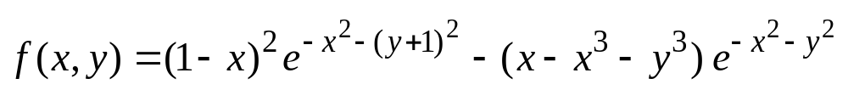
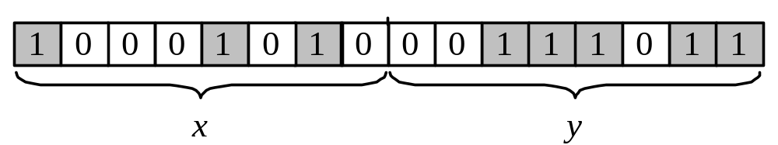
Genetic algorithms: case study
Suppose it is desired to find the maximum of the “peak” function of two variables:
where parameters x and y vary between 3 and 3.
The first step is to represent the problem variables as a chromosome  parameters x and y as a concatenated binary string:

Slide 3
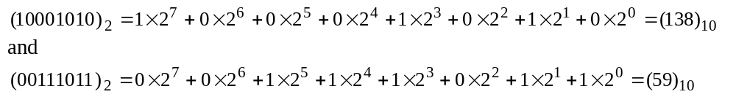
We also choose the size of the chromosome population, for instance 6, and randomly generate an initial population.
The next step is to calculate the fitness of each chromosome. This is done in two stages.
First, a chromosome, that is a string of 16 bits, is partitioned into two 8-bit strings:
Then these strings are converted from binary (base 2) to decimal (base 10):

Slide 4
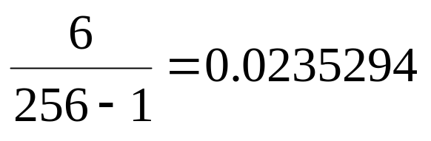
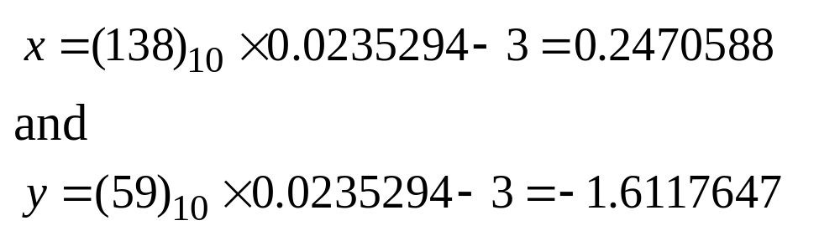
Now the range of integers that can be handled by 8-bits, that is the range from 0 to (2⁸  1), is mapped to the actual range of parameters x and y, that is the range from 3 to 3:
To obtain the actual values of x and y, we multiply their decimal values by 0.0235294 and subtract 3 from the results:

Slide 5
Using decoded values of x and y as inputs in the mathematical function, the GA calculates the fitness of each chromosome.
To find the maximum of the “peak” function, we will use crossover with the probability equal to 0.7 and mutation with the probability equal to 0.001. As we mentioned earlier, a common practice in GAs is to specify the number of generations. Suppose the desired number of generations is 100. That is, the GA will create 100 generations of 6 chromosomes before stopping.

Slide 6
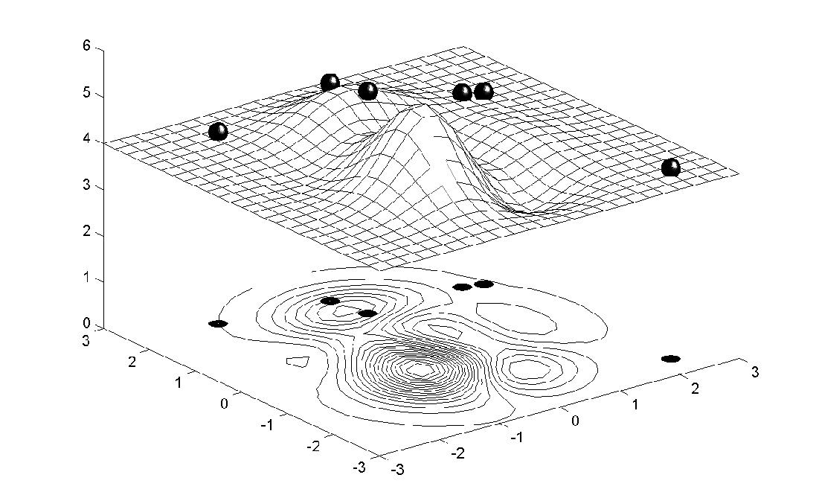
Chromosome locations on the surface of the “peak” function: initial population

Slide 7
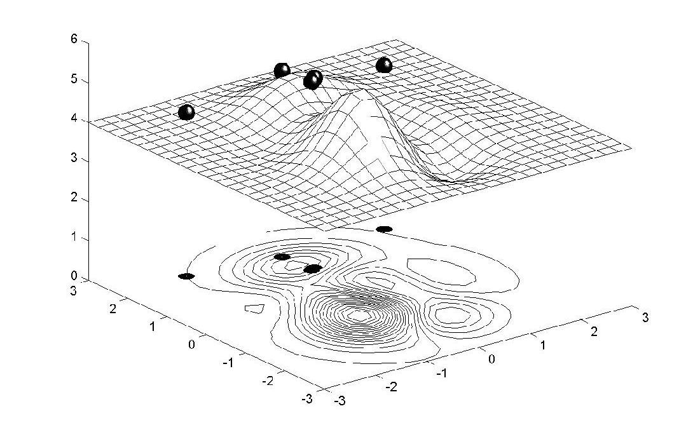
Chromosome locations on the surface of the “peak” function: first generation

Slide 8
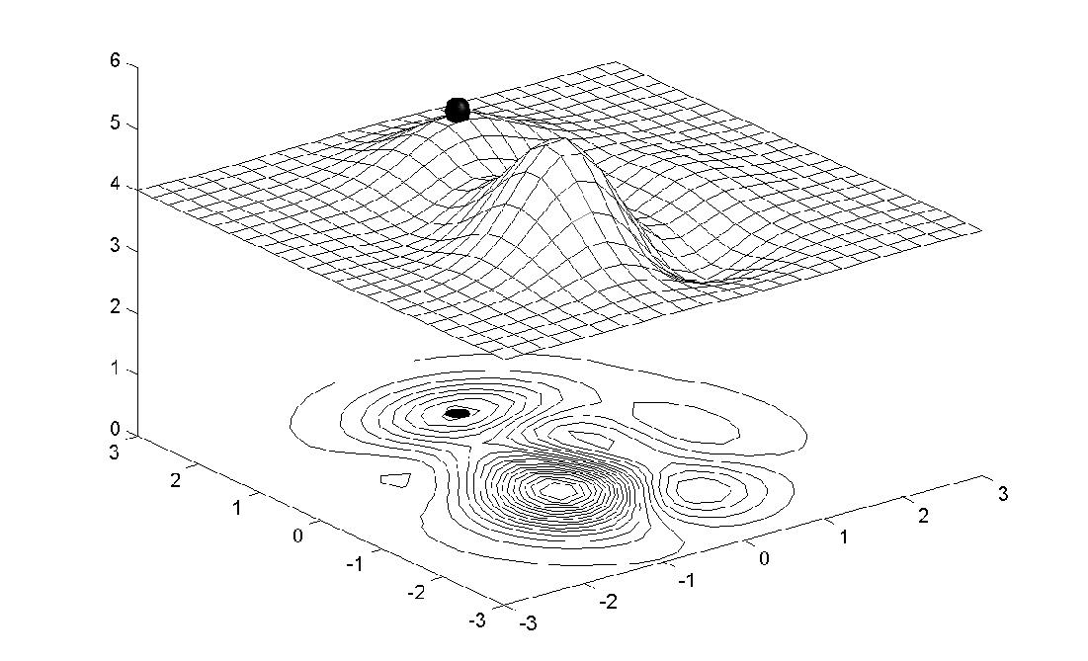
Chromosome locations on the surface of the “peak” function: local maximum

Slide 9
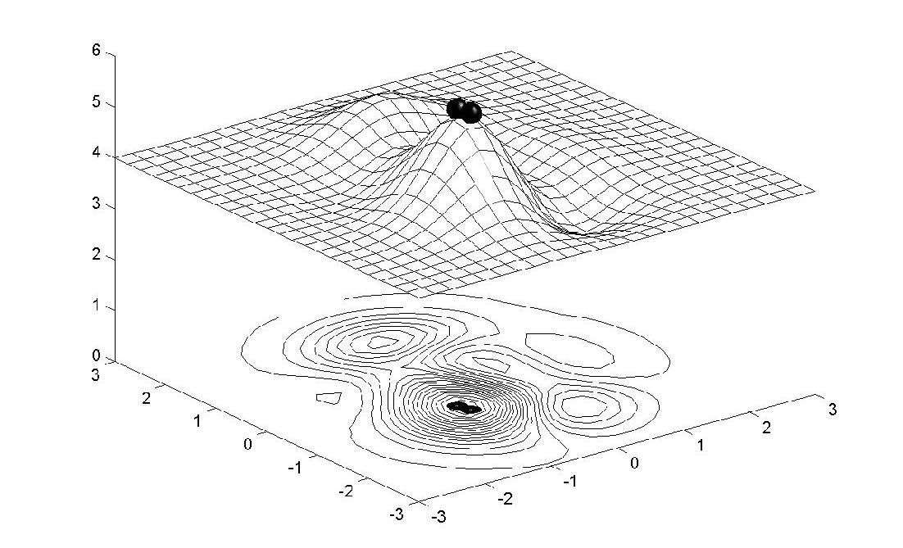
Chromosome locations on the surface of the “peak” function: global maximum

Slide 10
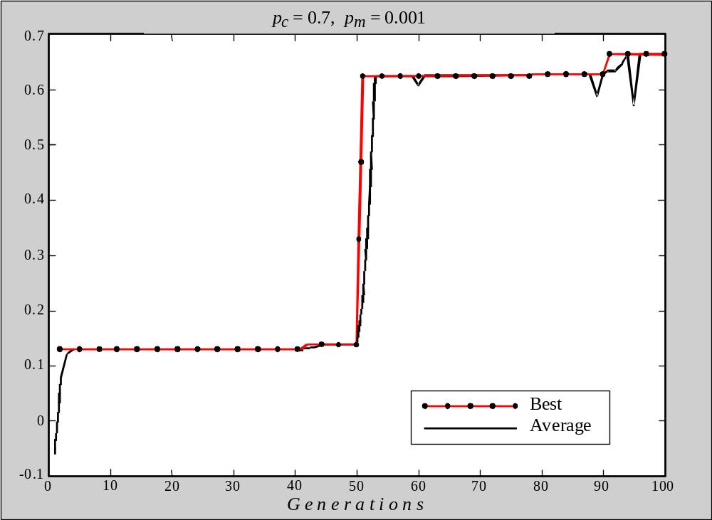
Performance graphs for 100 generations of 6 chromosomes: local maximum
F i t n e s s

Slide 11
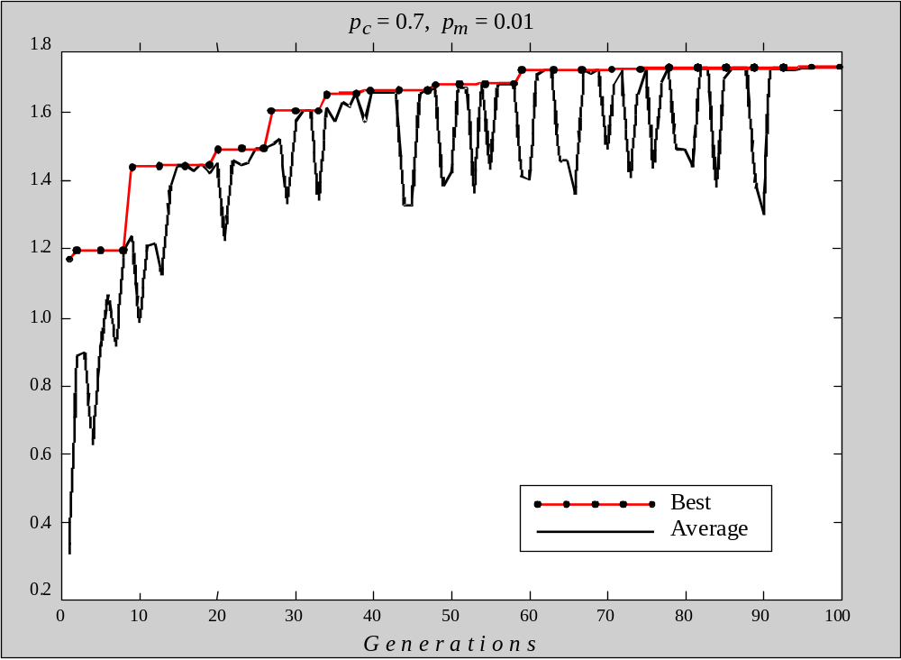
Performance graphs for 100 generations of 6 chromosomes: global maximum
F i t n e s s

Slide 12
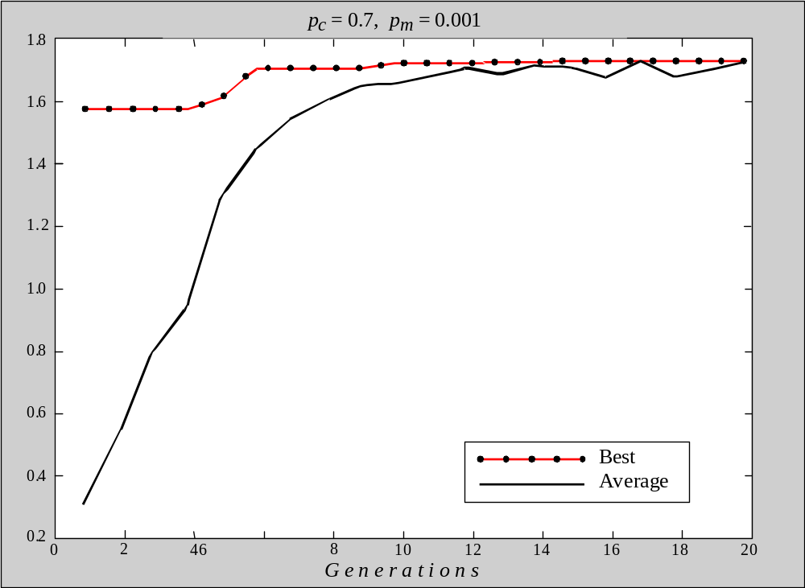
Performance graphs for 20 generations of
60 chromosomes
F i t n e s s

Slide 13
Case study
Unit data and maintenance requirements
Un
it
Un
it
ca
pa
ci
ty
,
Nu
mb
er
of
in
te
rv
al
s
re
qu
ir
ed
nu
mb
er
MW
fo
r
un
it
ma
in
tena
nc
e
1
20
2
2
15
2
3
35
1
4
40
1
5
15
1
6
15
1
7
10
1

Slide 14
Assume the maximum Capacity of Power Plant is 150 MW.
Net_ Reserve = Maximum Capacity – Capacity of the down units- Actual power Load
For example if 20MW unit is down for maintenance and actual power demand is 100MW, then Net Reserve is
150-20-100=30MW

Slide 15
Constraints of the Problem:
  Net Reserve should always be greater than 0
in all four quarters.
2. Maintenance of the unit starts at the beginning of the quarter and ends at the end of the quarter or the end of the adjacent quarter.

Slide 16
Constraints of the Problem:
Maximum Loads Expected during each quarter are as follows:
Quarter 1 80MW
Quarter 2 90MW
Quarter 3 65MW
Quarter 4 70MW

Slide 17
GA Process:
  Specify the problem, define constraints and optimum criteria
  Represent the problem domain as chromosome
  Define a fitness function to evalute the chromosome’s performance.
  Construct the genetic operators
  Run the GA and tune its parameters.

Slide 18
Optimization Criterion:
Net Reserve must be at the maximum during any maintenance period.

Slide 19
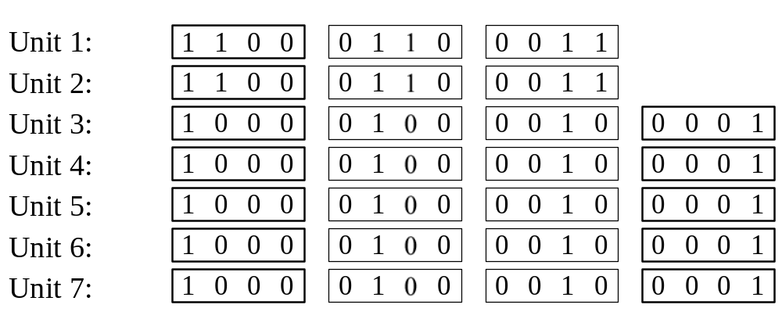
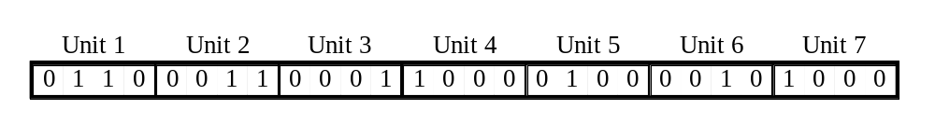
Case study
Unit gene pools
Chromosome for the scheduling problem

Slide 20
Explanation of Chromosome
Unit 1: 0110 shows that this unit is down for
Maintenance in the second and third quarter.
1 represents maintenance.
Unit 3: 0001, This represents that unit 3 is
down for maintenance in the fourth quarter.

Slide 21
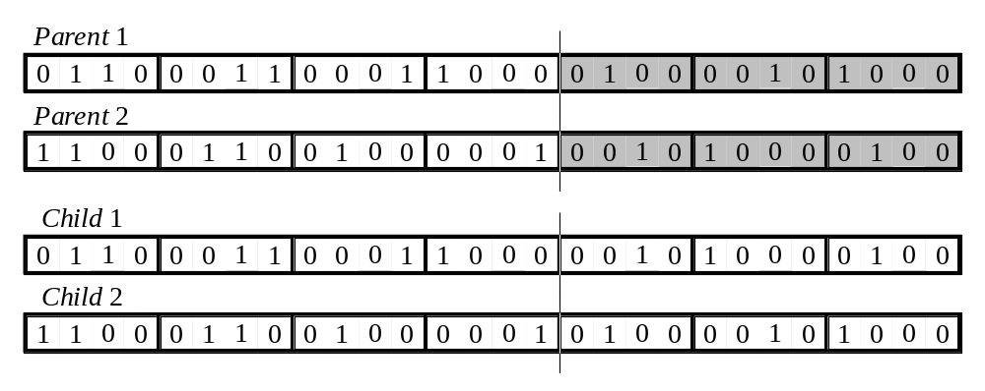
Case study
The crossover operator

Slide 22
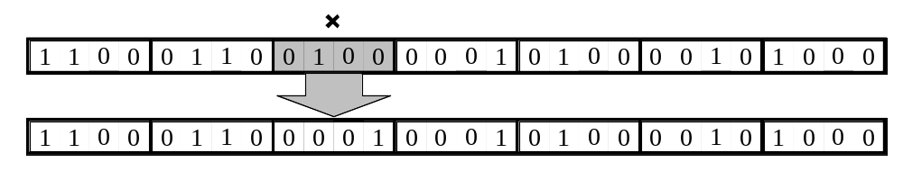
Case study
The mutation operator

Slide 23
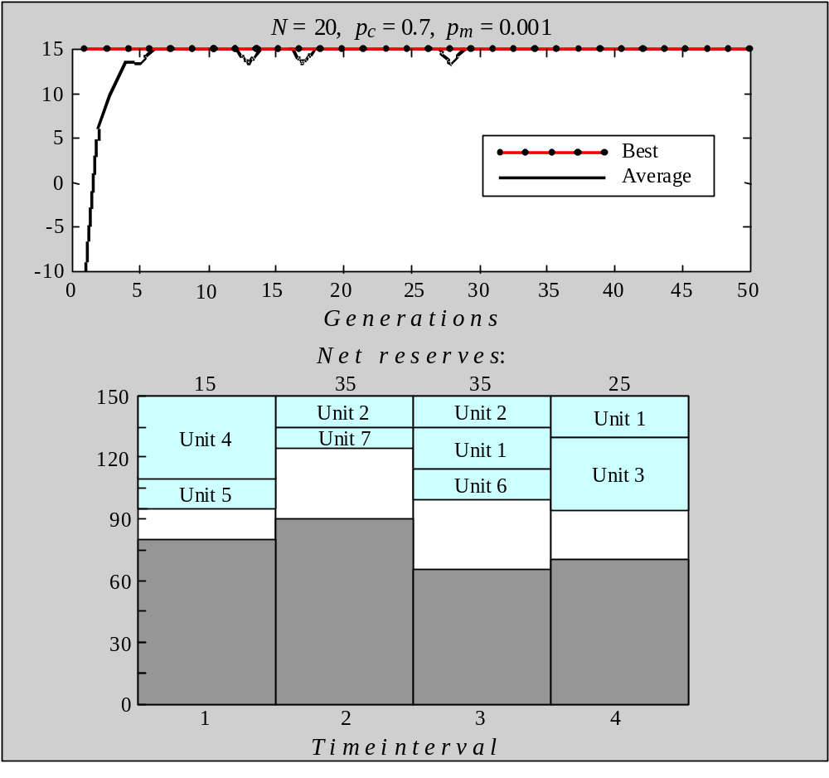
Performance graphs and the best maintenance schedules created in a population of 20 chromosomes
F i t n e s s
M W
(a) 50 generations

Slide 24
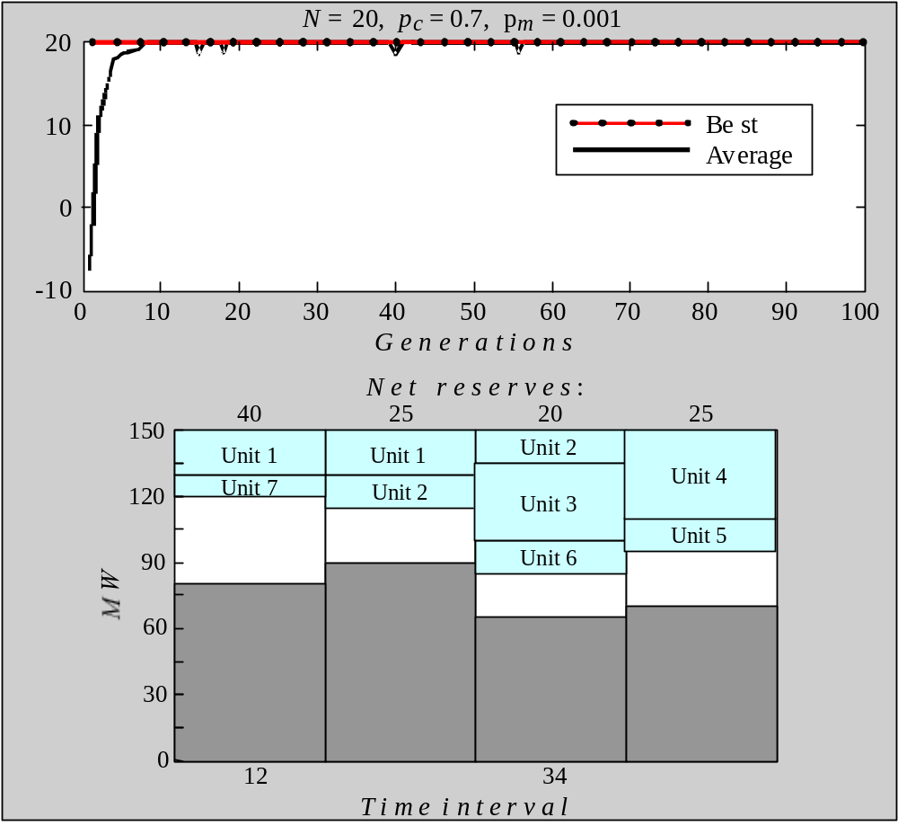
Performance graphs and the best maintenance schedules created in a population of 20 chromosomes
F i t n e s s
(b) 100 generations

Slide 25
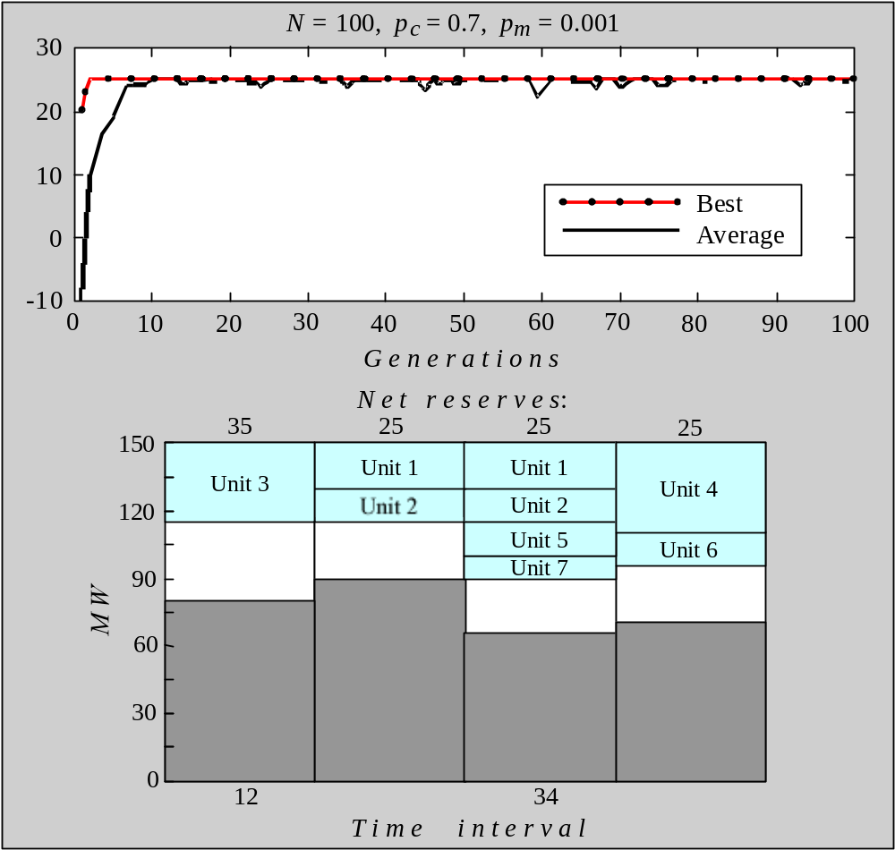
Performance graphs and the best maintenance schedules created in a population of 100 chromosomes
F i t n e s s
(a) Mutation rate is 0.001

Slide 26
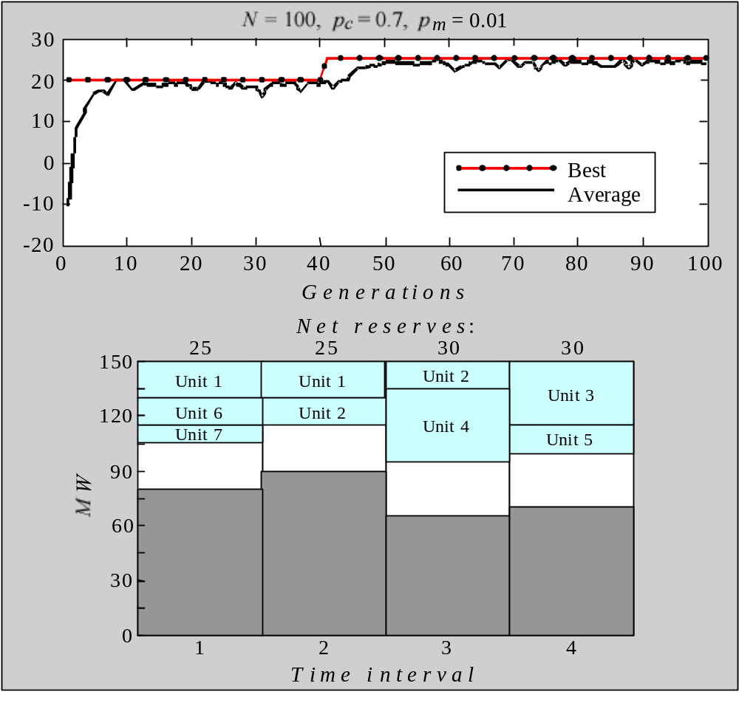
Performance graphs and the best maintenance schedules created in a population of 100 chromosomes
F i t n e s s
(b) Mutation rate is 0.01

